Slide 2


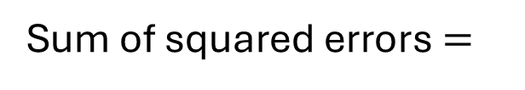
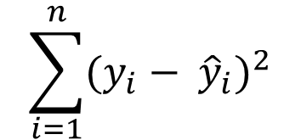

y
observation
$$y_{i}$$
For a single point:
error
error_{i} = observed_{i} – predicted
prediction
$${\hat{y}}_{i}$$
$ε_{i}=y_{i}−$ ${\hat{y}}_{i}$
For all points:
$$\sum_{i=1}^{n}{{(y_{i}− {\hat{y}}_{i})}^{2}}$$
Sum of squared errors$=$
x

Slide 3
y
y
SS = 100
SS = 50
x
x

Slide 4

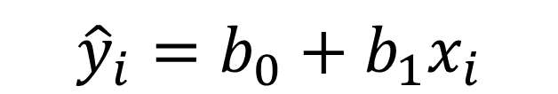
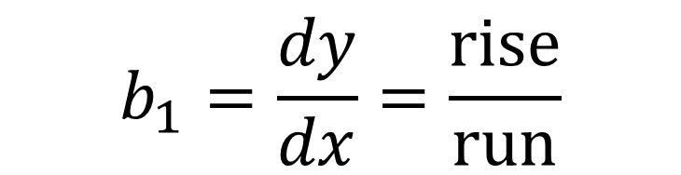
$${\hat{y}}_{i}={b_{0}+b_{1}x}_{i}$$
y
$$b_{1}=\frac{dy}{dx}=\frac{rise}{run}$$
$$b_{0}$$
y-intercept
x

